Slide 1
Fake News DETECTION
TITHI PATEL

Slide 2
Fake news Detection
This is the research Project based on Fake news detection.
Steps while working with the project:-
Collecting dataset
Formating data
Cross data text classification(SVM, LSTM, BERT,ALBERT)

Slide 3
Summarised information of Dataset
 | Source | size | Labels
KAGGLE_DATASET_Jruvika.csv | ISOT text | 4138 | 0(true),1(false)
ISOT_FAKE_NEWS_DATASET.csv | text | 45386 | 0(true),1(false)
UTK_FAKE_NEWS_DATASET.csv | Text | 20681 | 0(true),1(false)
G_McIntire_FAKE_NEWS_DATASET_.csv | Text | 6332 | 0(true),1(false)
COVID-19_Tweets_FAKE_NEWS_DATASET.csv | Tweet | 10700 | 0(true),1(false)
LIAR_FAKE_NEWS_DATASET.csv | Text | 12811 | 0(true),1(false)
To know more about it pl. Visit readme of dataset folder

Slide 4
More about Dataset
DATASET | Fake_news | Real_news | Total
KAGGLE_DATASET_Jruvika.csv | 2120 | 2018 | 4138
ISOT_FAKE_NEWS_DATASET.csv | 22535 | 22851 | 45386
UTK_FAKE_NEWS_DATASET.csv | 10379 | 10302 | 20681
G_McIntire_FAKE_NEWS_DATASET_.csv | 3161 | 3171 | 6332
COVID-19_Tweets_FAKE_NEWS_DATASET.csv | 5100 | 5600 | 10700
LIAR_FAKE_NEWS_DATASET.csv | 5723 | 7088 | 12811

Slide 5

SVM
SUPPORT VECTOR MACHINE
SVM is an algorithm that determines the best decision boundary between vectors that belong to a given group (or category) and vectors that do not belong to it.

Slide 6
Crossdata for dataset
using svm text classification
 | KAGGLE_DATASET_Jruvika.csv | ISOT_FAKE_NEWS_DATASET.csv | UTK_FAKE_NEWS_DATASET.csv | G_McIntire_FAKE_NEWS_DATASET_.csv | COVID-19_Tweets_FAKE_NEWS_DATASET.csv | LIAR_FAKE_NEWS_DATASET.csv
KAGGLE_DATASET_Jruvika.csv | 0.996857 | 0.268613 | 0.33491 | 0.652805 | 0.379987 | 0.361208
ISOT_FAKE_NEWS_DATASET.csv | 0.240904 | 0.999339 | 0.464269 | 0.340411 | 0.343558 | 0.356166
UTK_FAKE_NEWS_DATASET.csv | 0.328798 | 0.652671 | 0.992312 | 0.239917 | 0.343819 | 0.356262
G_McIntire_FAKE_NEWS_DATASET_.csv | 0.575959 | 0.325768 | 0.249099 | 0.982944 | 0.455666 | 0.488798
COVID-19_Tweets_FAKE_NEWS_DATASET.csv | 0.574787 | 0.459138 | 0.492539 | 0.464837 | 0.883527 | 0.479418
LIAR_FAKE_NEWS_DATASET.csv | 0.432264 | 0.430387 | 0.439847 | 0.471184 | 0.37557 | 0.551752

Slide 7
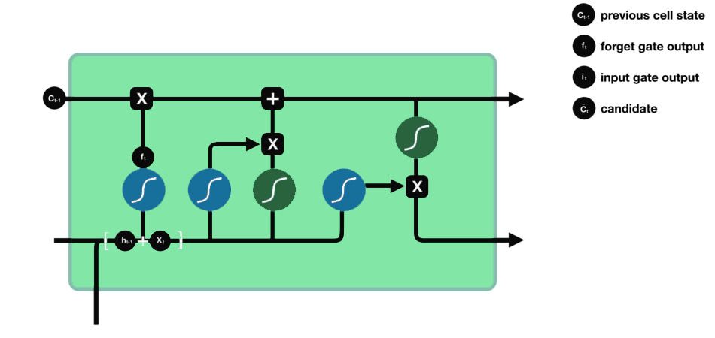
LSTM
Long-Short Term Memory.
LSTM stands for LSTM is a type of recurrent neural network but is better than traditional recurrent neural networks in terms of memory.

Slide 8
Crossdata for dataset
using LSTM text classification
 | KAGGLE_DATASET_Jruvika.csv | ISOT_FAKE_NEWS_DATASET.csv | UTK_FAKE_NEWS_DATASET.csv | G_McIntire_FAKE_NEWS_DATASET_.csv | LIAR_FAKE_NEWS_DATASET.csv | COVID-19_Tweets_FAKE_NEWS_DATASET.csv
KAGGLE_DATASET_Jruvika.csv | 0.992263 | 0.279106 | 0.27921 | 0.5944 | 0.535936 | 0.530232
ISOT_FAKE_NEWS_DATASET.csv | 0.323823 | 0.98982 | 0.699814 | 0.384379 | 0.464543 | 0.369012
UTK_FAKE_NEWS_DATASET.csv | 0.213431 | 0.809695 | 0.965668 | 0.229321 | 0.457604 | 0.356849
G_McIntire_FAKE_NEWS_DATASET_.csv | 0.798426 | 0.258615 | 0.206263 | 0.959254 | 0.584734 | 0.509857
LIAR_FAKE_NEWS_DATASET.csv | 0.785976 | 0.39777 | 0.398167 | 0.807485 | 0.837823 | 0.536448
COVID-19_Tweets_FAKE_NEWS_DATASET.csv | 0.644689 | 0.395315 | 0.454195 | 0.678174 | 0.652649 | 0.964621

Slide 9
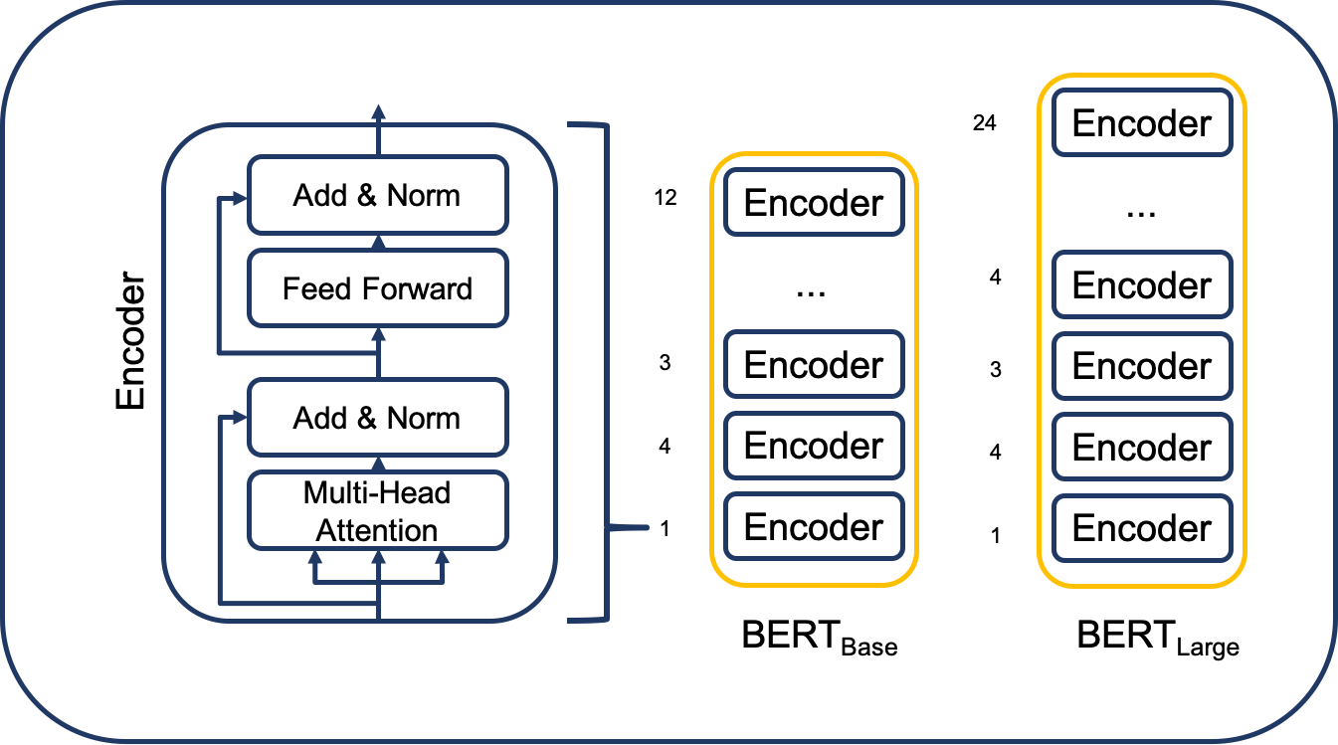
BERT
Bidirectional Encoder Representations from Transformers
It is a deep learning model in which every output element is connected to every input element, and the weightings between them are dynamically calculated based upon their connection.

